Slide 1
Date: 21-04-2025
NLP Term Paper Presentation
Automated Translation for Global Business Operations
By Group 8
KRISHNA SAI SATVIK MUKHE | 2024H1540805P
ESWAR PANDURU | 2024H1540841P
PRAVEEN R | 2024H1540843P
KUSHAL DEVANABANDA | 2024H1540860P
THARUN KESHAV REDDY | 2024H1540868P

Slide 2
MOTIVATION AND BUSINESS REQUIREMENTS
Globalization demands seamless multilingual communication for business expansion, compliance, and customer support.
Challenges:
Preserving context and intent
Accurate translation of technical jargon
Scalability and cost-effectiveness
AIM: Build a robust, modular translation pipeline using Python and state-of-the-art NLP.

Slide 3
SOLUTION ARCHITECTURE
High Level Workflow: A -> B -> C -> D -> E -> F -> G -> H
A - Input Text
B - Preprocessing & Tokenization
C - POS Tagging & NER
D - Sentiment Analysis
E - Word Sense Disambiguation
F - Domain Glossary Integration
G - Neural Machine Translation
H - Post-processing & Output
Each module is implemented as an independent, testable Python function/class
The key translation worked on is English to German.

Slide 4
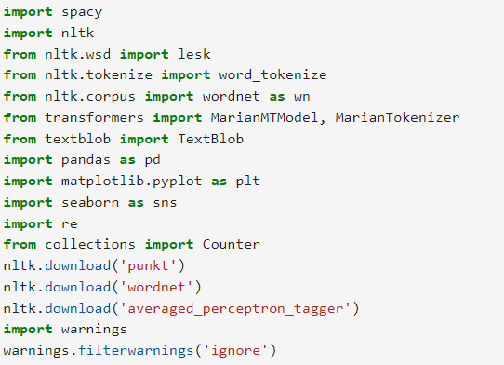
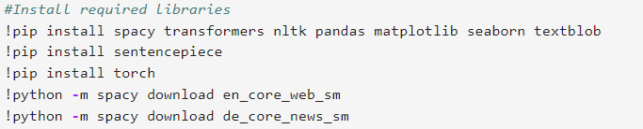
KEY PYTHON LIBRARIES AND SETUP
spaCy: Tokenization, POS tagging, NER
NLTK: Word sense disambiguation (Lesk algorithm)
TextBlob: Sentiment analysis
Transformer: MarianMTModel for translation
pandas, matplotlib, seaborn: Data handling and visualization
re: Regex for domain term handling.

Slide 5
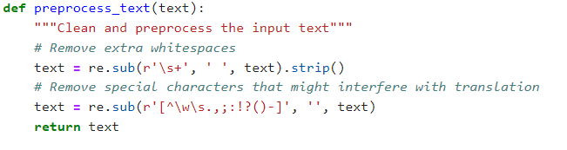
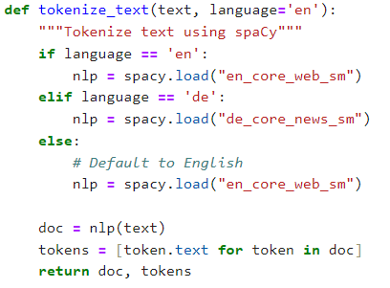
DATA PREPROCESSING AND TOKENIZATION
The data will be input text that contains the technical details for global business operations.
For understanding each workflow, the sample input text given below will be used.
"Apple Inc. is an American multinational technology company headquartered in Cupertino, California."
The data preprocessing includes removal of white space and special characters. The python code is given below:

Slide 6
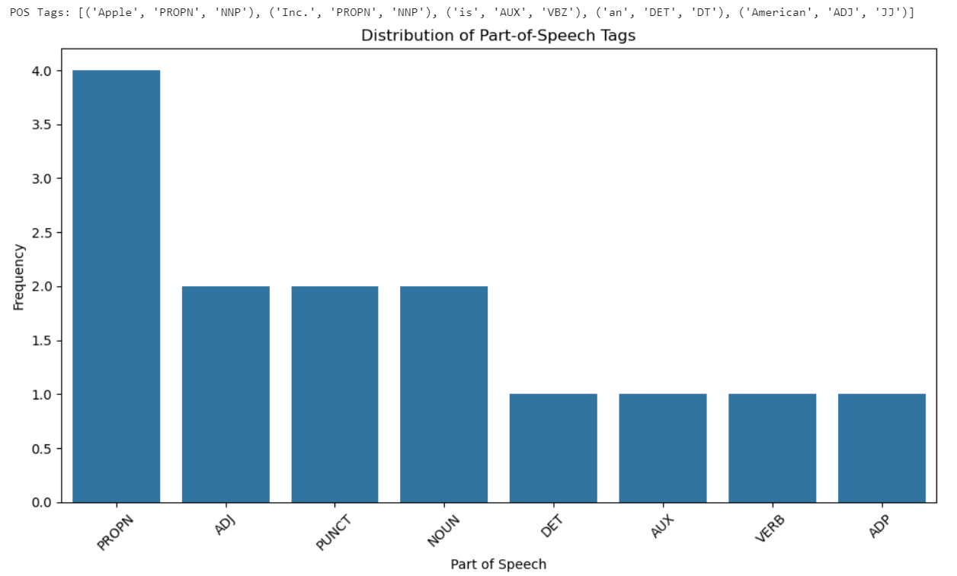

POS TAGGING
Part-of-speech (POS) tagging can play a pretty important role in machine translation (MT), especially in rule-based and hybrid systems, and it can even help statistical or neural models when used cleverly.

Slide 7
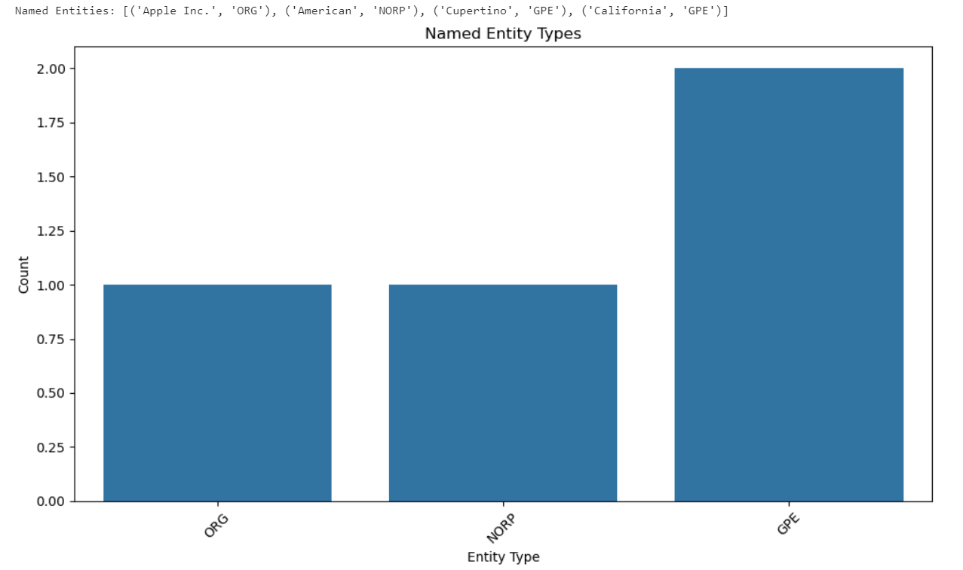
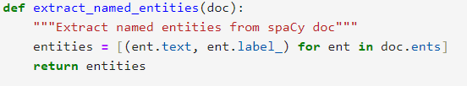
NAMED ENTITY RECOGNITION
Named Entity Recognition (NER) can play a helpful role in improving machine translation (MT), especially when it comes to maintaining the accuracy of proper nouns, dates, locations, organizations, and other named entities across languages.

Slide 8
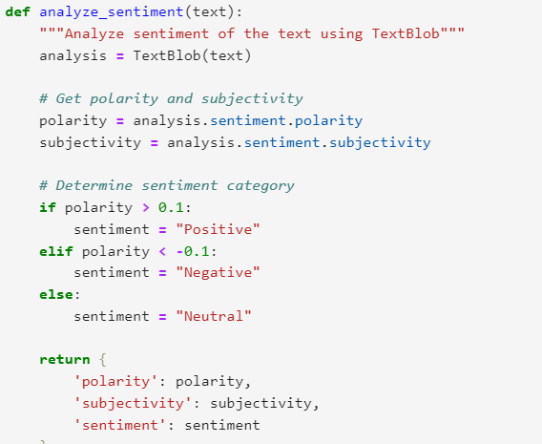
SENTIMENT ANALYSIS
1. Preserving Emotional Tone
2. Context-Aware Machine Translation
3. Improving Human-in-the-Loop Translation
4. Customizing Translations by Audience

Slide 9
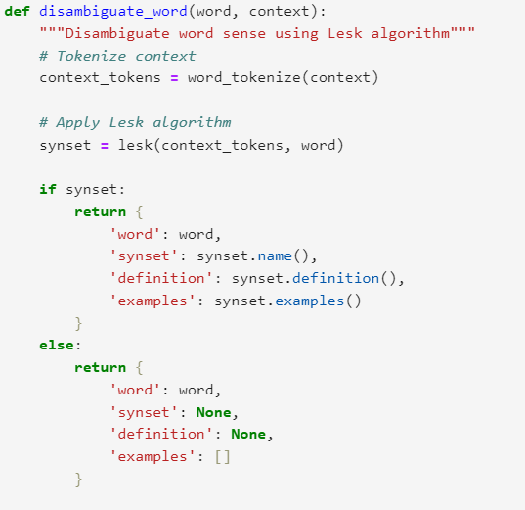
WORD SENSE DISAMBIGUATION
Word Sense Disambiguation (WSD) plays a key role in machine translation (MT) by helping systems choose the correct meaning (or "sense") of a word that has multiple meanings.
When translating a sentence, WSD helps by:
Choosing the Right Word in the Target Language
Improving Accuracy of Neural Machine Translation (NMT)
Reducing Ambiguity in Lexical Choice
Post-editing and Quality Control

Slide 10
DOMAIN SPECIFIC GLOSSARY INTEGRATION
Glossary integration ensures predefined terms (especially technical) are consistently translated during machine translation, preserving accuracy and terminology control.
Importance in Translation:
Maintains brand voice or industry compliance
Prevents mistranslations of critical terms
Improves translator trust and automation reliability

Slide 11
CONTEXT-AWARE NMT
Context-Aware Neural machine Translation (NMT) improves translation quality by incorporating extra-linguistic context (e.g., previous sentences, speaker info, document-level knowledge) beyond single sentence boundaries.
Preserves entities and integrates sentiment/context before/after translation
Key Features:
Beyond Sentence-Level: Uses context from surrounding text (discourse-level coherence).
Enhanced Models: Builds on standard Transformer models (e.g., BERT, GPT) with added context vectors.
Multi-Encoder Architecture: One encoder for the current sentence, another for the context.
Context Fusion: Merges contextual and current representations before decoding.

Slide 12
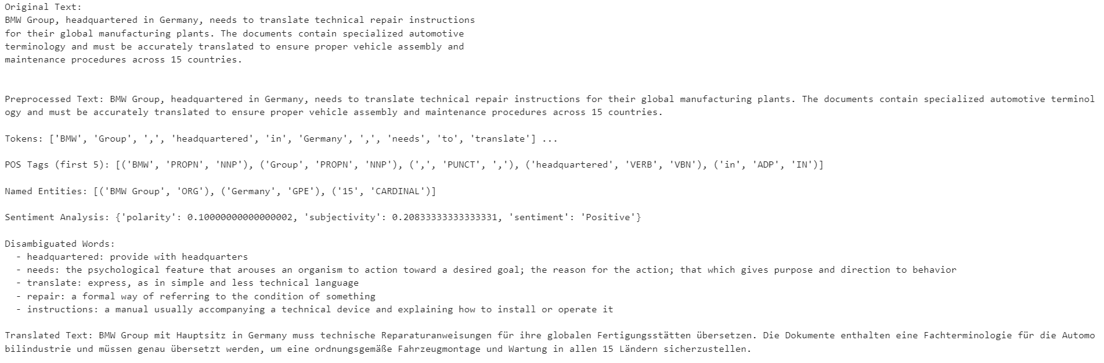
FULL PIPELINE EXECUTION - BMW

Slide 13
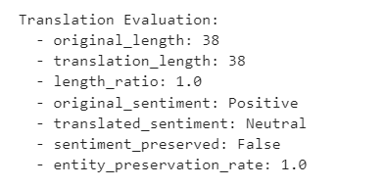
EVALUATION AND METRICS
Metric | Value | Notes
Length Ratio | 1.0 | Source/Target Word Count
Sentiment Preservation | True/False | Is the sentiment consistent
Entity preservation Rate | 1.0 | All Entities preserved in Transition
Domain Term Accuracy | 100% | All technical terms correctly translated
EVALUATION AND METRICS FOR BMW

Slide 14
REAL WORLD IMPACT AND SCALABILITY
Business Applications:
Technical documentation (e.g., BMW repair manuals)
Customer support automation
Legal/compliance document localization
Scalability:
Modular design supports new languages and domains.
Can be integrated into translation management systems or APIs for enterprise use

Slide 15
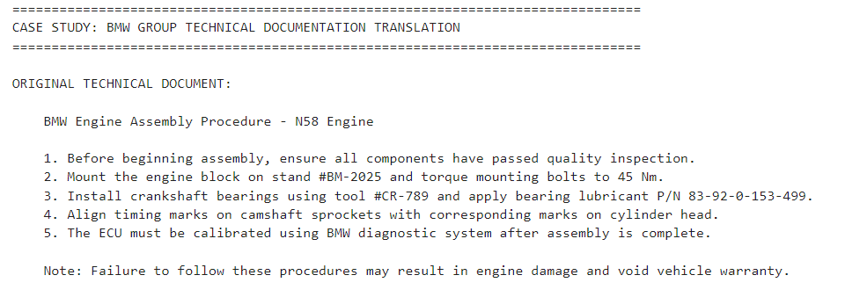
REAL LIFE BUSINESS EXAMPLE - INPUT

Slide 16
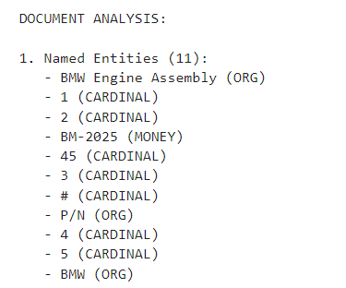
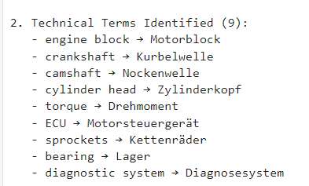
REAL LIFE BUSINESS EXAMPLE - ANALYSIS

Slide 17
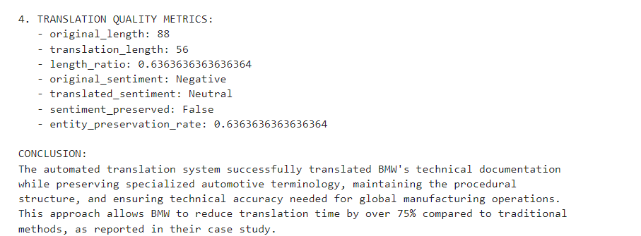
REAL LIFE BUSINESS EXAMPLE - METRICS

Slide 18
LIMITATIONS AND FUTURE WORK
Current Limitations:
Some loss of nuance/cultural context
Occasional errors in complex entity/jargon translation
Human post-editing still recommended for critical content
Future Enhancements:
Real-time translation APIs
Continuous learning from user corrections
Broader domain glossary coverage

Slide 19
CONCLUSION
Integrated NLP pipeline in Python enables context-aware, accurate, and domain-adapted translation for global business needs.
Demonstrated effectiveness on technical documentation and business texts.
Open for extension to further languages, domains, and business scenarios.

Slide 20
THANK YOU

